Slide 1
DMAP
Project Presentation

Slide 2
The main objective of our project is implementing Dijkstra’s algorithm to a map, and developing the result in a helpful real world application.
Since implementing Dijkstra’s algorithm was done in stages, the following slides will briefly detail the whole process.

Slide 3
Database Creation
Database – Android Studio Linkage
Position Fetching
Vertex Addition
Path Determination

Slide 4
Database Creation
Creating the routes using an online site ‘graph.latcoding.com’ by adding vertices and linking them with nodes in between, each containing its coordinates.
Exporting the resulting graph as a JSON format file containing the coordinates.
Converting the obtained JSON coordinates into an appropriate data that can be inserted into the database table ‘graph’ alongside the starting vertex, ending vertex and path that contains all the coordinates.
Exporting the database as a sqlite format file and storing it in the mobile storage before.

Slide 5
Database – Android Studio Linkage
The Database was linked using 2 classes, SQLHelper.java and GraphToArray.java:
SQLHelper.java class was used to open connection with the database.
GraphToArray.java class was used to store the data present in the graph table in the form of a two-dimensional array containing :
The first index as the start vertex.
The second index as the designated path.
Having as a value the end vertex with its weight that represents the distance between these vertices.

Slide 6
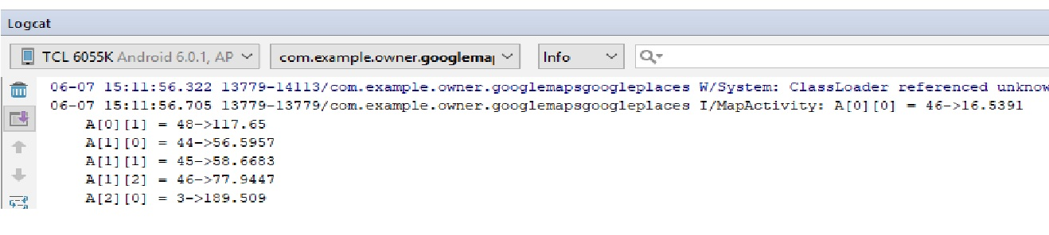

Slide 7
Position Fetching
Using the class GetCoordinates.java :
Fetch the start and end vertex of the path closest to the designated position.
Fetch the node between these latter vertices which is also closest to the designated position.
Determine the status of the path:
No path, if the fetched node coincides with either the start or end vertex.
Double path, if the fetched node lies between the vertices having a bidirectional path.
Single path, if the fetched node lies between the vertices having a unidirectional path.

Slide 8
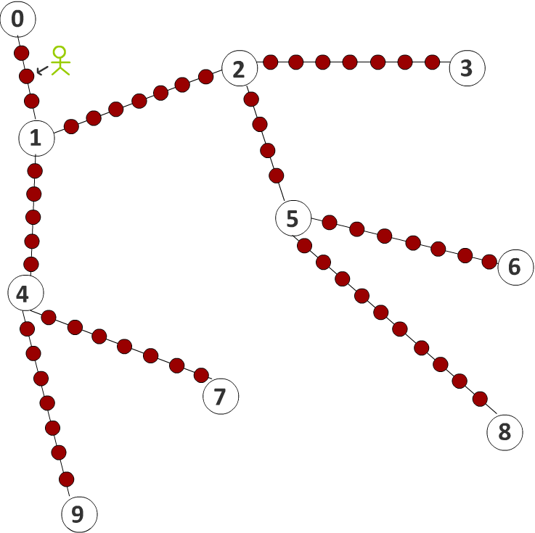

Slide 9
Vertex Addition
Two classes where used for adding a node as a new vertex in the database:
AddVertex.java:
Modifies the database:
Delete the rows containing the paths fetched earlier with their vertices.
Insert the new start and end vertex with the node fetched earlier representing either one, contained within the old vertices.
Insert the new weight by calling NewWeight.java.
NewWeight.java:
Calculates the weight of the new added paths.
Note: The weight represents the distance between the start and end vertices.

Slide 10
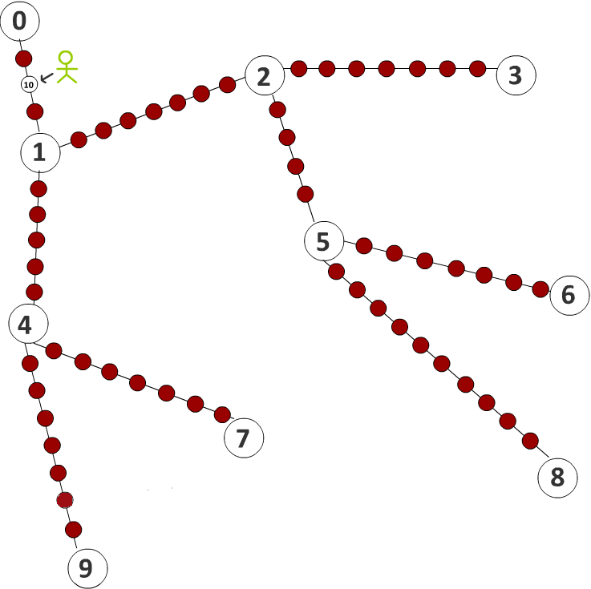

Slide 11
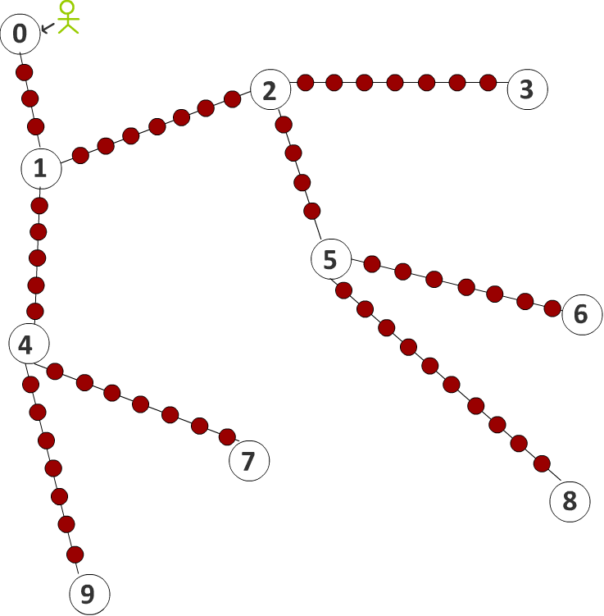

Slide 12
Path Determination
Using Dijkstra.java class the following steps were done:
Selects the path with the minimum weight from the source position and marks it as true.
Blocks all other paths leading to the end vertex of the newly selected path.
Loops between the previous steps until it reaches the destination position.
Adjusting the paths that were marked as true to form the final path from source to destination.
Returning the established path in order to draw the route on the map.

Slide 13


Slide 14

DMAP AND DIJKSTRA
Every supermarket suffers from delivery complaints.
Orders sometimes reach the customer late due to many factors(forgetting the customer’s home address, taking a longer road than the shortest one…).
We created an application where the delivery guy uses DMAP to find the shortest path possible reaching the customer’s location.

Slide 15
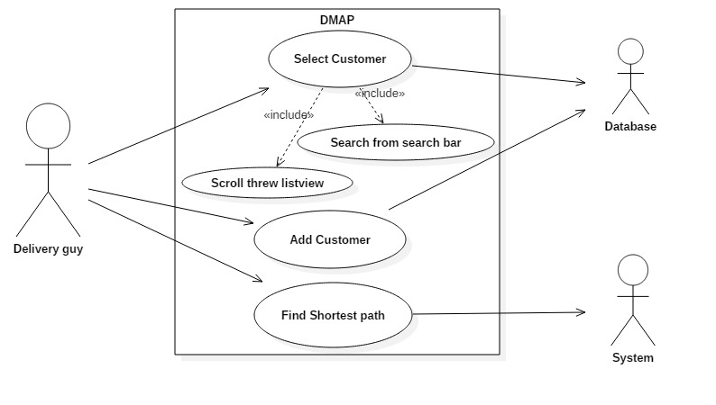

Slide 16
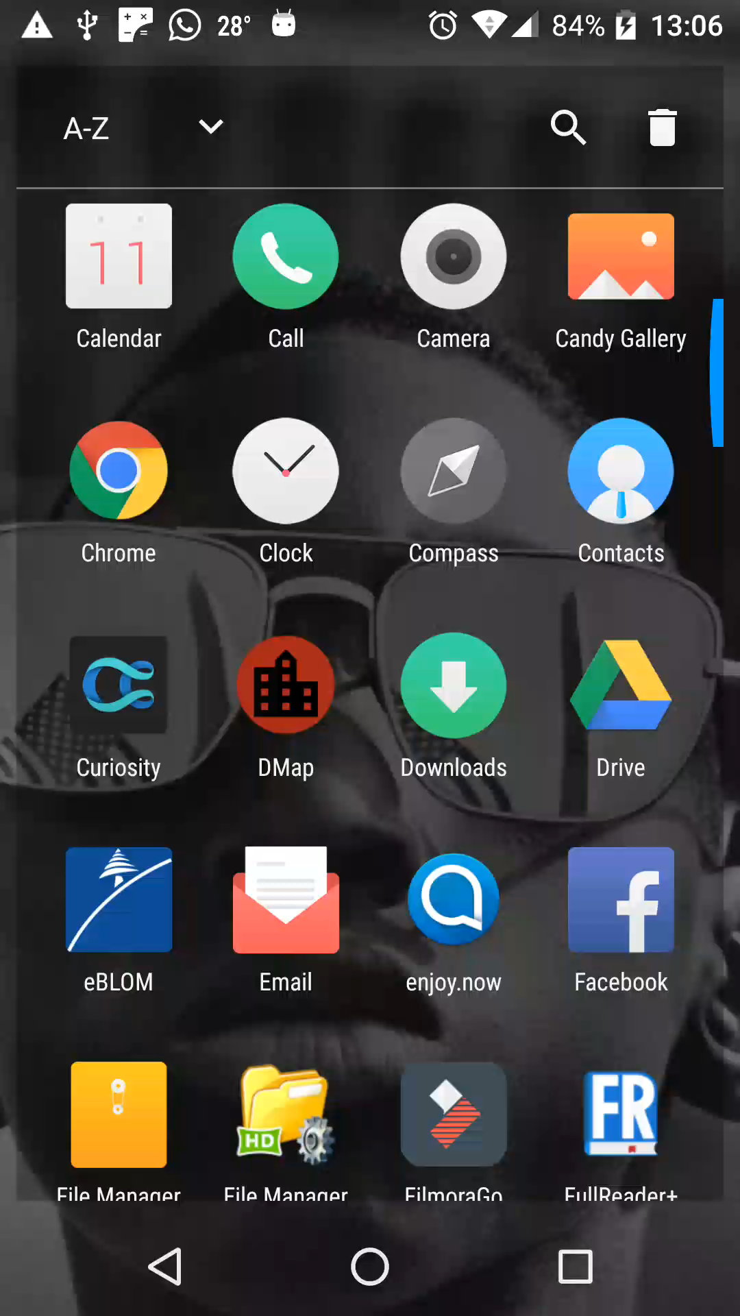
Dmap and dijkstra !
How does it work ? Simple:
Delivery man opens his application.
Chooses the ‘Reach customer’ button.
Chooses the name of the customer
Upon click, a small map appears showing the shortest path between the delivery’s location and the customer’s address

